Slide 1


Functional programming in concurrent and distributed systems
381-1-0112 | SM B 2020 | Tutorial 3
David Leon

Slide 2
Outline
Understanding errors
Compilation errors
Run-time errors
Example
Map expressions
Record
Guards
if
case... of
Recursions
Submission procedures

Slide 3
#1.1 Compilation Errors
Compile-time errors are often syntactic mistakes
Check your function names
Check the tokens in the language (brackets, parentheses, periods, commas)
Check the arity of your functions, etc.

Slide 4
#1.1 Compilation Errors
module.beam: Module name 'madule' does not match file name 'module'
The module name you've entered in the -module attribute doesn't match the filename.
./module.erl:2: Warning: function some_function/0 is unused
You have not exported a function, or the place where it's used has the wrong name or arity. It's also possible that you've written a function that is no longer needed.
./module.erl:2: function some_function/1 undefined
The function does not exist. You've written the wrong name or arity either in the -export attribute or when declaring the function. This error is also output when the given function could not be compiled, usually because of a syntax error like forgetting to end a function with a period.
./module.erl:5: syntax error before: 'SomeCharacterOrWord'
This happens for a variety of reasons, namely unclosed parentheses, tuples or wrong expression termination (like closing the last branch of a case with a comma). It might be the use of a reserved atom in your code.

Slide 5
#1.1 Compilation Errors
./module.erl:5: syntax error before:
This usually comes up when your line termination is not correct.
./module.erl:5: Warning: this expression will fail with a 'badarith' exception
In this case, the compiler is smart enough to find that one of your arithmetic expressions will fail (say, llama + 5). It won't find type errors much more complex than that, though.
./module.erl:5: Warning: variable 'Var' is unused
You declared a variable and never use it afterwards. You might want to switch the variable name to _ or just prefix it with an underscore (something like _Var) if you feel the name helps make the code readable.

Slide 6
#1.1 Compilation Errors
./module.erl:5: Warning: a term is constructed, but never used
This warning tells you you're doing something useless: you're doing something such as building a list, declaring a tuple or an anonymous function without ever binding it to a variable or returning it.
./module.erl:5: head mismatch
It's possible your function has more than one head, and each of them has a different arity (different arity means different functions!). This error is also raised when you insert a function definition between the head clauses of another function.
./module.erl:5: Warning: this clause cannot match because a previous clause at line 4 always matches
The compiler warns you that you'll never even need to go to the other branch.
./module.erl:9: variable 'A' unsafe in 'case' (line 5)
You're using a variable declared within one of the branches of a case ... of outside of it. This is considered unsafe. If you want to use such variables, you'd be better of doing MyVar = case ... of...

Slide 7
#1.2 Run-time Errors
Run-time errors are pretty destructive in the sense that they crash your code. While Erlang has ways to deal with them, recognizing these errors is always helpful.

Slide 8

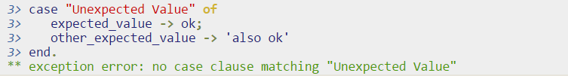
#1.2 Run-time Errors
All the guard clauses of a function failed, or none of the function clauses' patterns matched.
You have forgotten a specific pattern in the case…, sent in the wrong kind of data, or needed a catch-all clause!

Slide 9

#1.2 Run-time Errors
it can not find a branch that evaluates to true.
Badmatch errors happen whenever pattern matching fails.
Note that this error sometimes happens because the programmer believes that a variable of the form _Var is not the same as _. Variables with an underscore are normal variables, except the compiler won't complain if they're not used. It is not possible to bind them more than once.

Slide 10


#1.2 Run-time Errors
it's about calling functions with incorrect arguments:
This happens when you call a function that doesn't exist:
This happens when you try to do arithmetic that doesn't exist, like divisions by zero or between atoms and numbers:

Slide 11
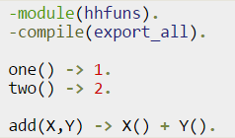
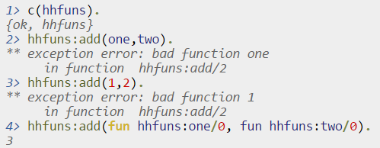
#1.2 Run-time Errors
The most frequent reason why this error occurs is when you use variables as functions, but the variable's value is not a function:
Code Shell

Slide 12
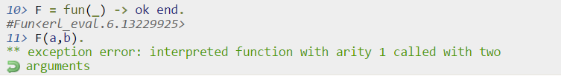
#1.2 Run-time Errors
It happens when you use higher-order functions, but you pass them more (or fewer) arguments than they can handle.

Slide 13
#1.3 Understanding Errors
By using your Erlang shell, type these commands and examine what each performs or the errors that you get in response
2#1101,
18#11.
N=1. <Enter> N=2.
b().
Number=1.
N==Number.
f(N).
number=1.
{N,T}={number,1}.
Have you got an error? Why? What is N’s value?
{_,_}={1,2}.
{_N,_N}={1,2}.
What is the difference between these commands?
f().
[{L,M} || L<-[1,2,3], M<-[1,2,3]].

Slide 14
#2 Map Expressions
Map expression is a term, a structure of pairs of terms
Each pair is treated as key and value
Can be used as a dictionary of state variable, small DB, etc.
Expressions are evaluated before the assignment
If two matching keys are declared, the latter key will take precedence
(The equivalent of dictionary from python)
M0 = #{}, % empty map
M1 = #{a => <<"hello">>}, % single association with literals
M2 = #{1 => 2, b => b}, % multiple associations with literals
M3 = #{k => {A,B}}, % single association with variables
M4 = #{{"w", 1} => f()}. % compound key associated with an eval. expression

Slide 15
#2 Map Expressions – Cont.
Put new value in map (maps:put/3)
If K does not match any key in M, a new association will be created
If K matches a key in M, its associated value will be updated to V
In both cases the evaluated map expression will return an updated map
To only update an existing value, use the following syntax (maps:update/3)
If K does not match any key in M, a badarg will be triggered at runtime
If K is present in M, its associated value will be replaced by V
The evaluated map expression returns a new map
M#{ K => V } % M is a term of type map and K and V are any expression
M#{ K := V } % M is the map, K evaluates to a key in M and V is an expression

Slide 16
#2 Map Expressions – Cont.
Example – put and update operations on map:
1> M = #{1 => a}.
#{1 => a }
2> M#{1.0 => b}.
#{1 => a, 1.0 => b}.
3> M#{1 := b}.
#{1 => b}
4> M#{1.0 := b}.
** exception error: bad argument

Slide 17
#2 Map Expressions – Cont.
Maps in patterns
Key K has to be an expression of bound variables or literals
V can be any pattern of either bound or unbound variables
If V is unbounded, it will be bounded to the value associated with K, that exist in M
If the variable V is bounded, it has to match the value associated with K in M
Example
#{ K := V } = M % M is a term of type map and K and V are any expression
#{ K1 := V1, .., Kn := Vn } = M % multiple values
1> M = #{"tuple" => {1,2}}.
#{"tuple" => {1,2}}
2> #{"tuple" := {1,B}} = M.
#{"tuple" => {1,2}}
3> B.
2.

Slide 18
#2 Map Expressions – Cont.
Example with literals in function heads
More information here and here
%% only start if not_started
handle_call(start, From, #{ state := not_started } = S) ->
...
{reply, ok, S#{ state := start }};
%% only change if started
handle_call(change, From, #{ state := start } = S) ->
...
{reply, ok, S#{ state := changed }};

Slide 19
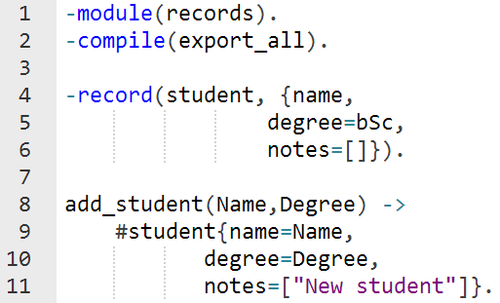
Records
Another way to set new types is records
Similar to structures in other languages
Example:

Slide 20
Records
Example
-module(record_example).
-record(person, {name, phone, address}).
-export([recorde_example/0]).
record_example() ->
Person = #person{name="John", phone=”972555", address="123 Main St."},
io:format("name: ~p, phone ~p address ~p",[Person#person.name, Person#person.phone, Person#person.address]).

Slide 21
#3 Guards
Pattern matching is somewhat limited since it can’t express some logics such as:
Select range of value
Apply constraints for certain types of data
Guards are additional clauses that can go in a function's head to make pattern matching more expressive
The comma “,” acts in a similar way as the operator and
The semicolon “;” acts in a similar way as the operator or
You can use math operations and functions on data types
A*B/C >= 0
is_integer/1 or is_atom/1

Slide 22
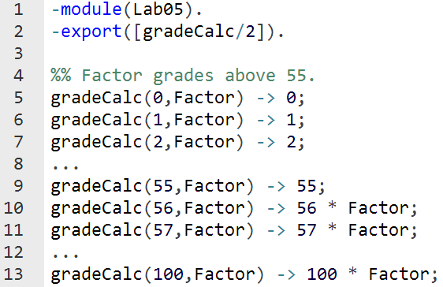

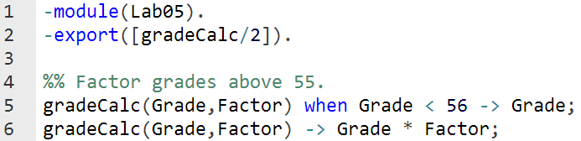
#3 Guards - Motivation
We would like to calculate a student’s grade in an exam, where a grade is factored if it’s higher than 56
It appears that pattern matching is not the easiest way to do it

Slide 23
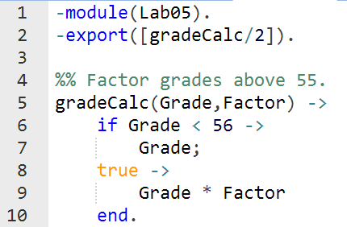
#3.1 if
If act like guards and share guards' syntax, but outside of a function clause's head
Let’s apply it to our problem:

Slide 24
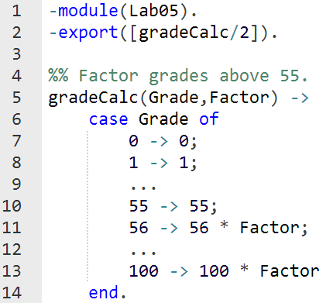
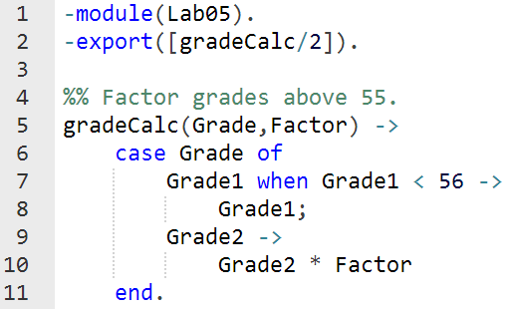
#3.2 Case… of
If the if expression is like a guard, a case... of expression is like the whole function head
You can have the complex pattern matching you can use with each argument, and you can have guards on top of it!

Slide 25
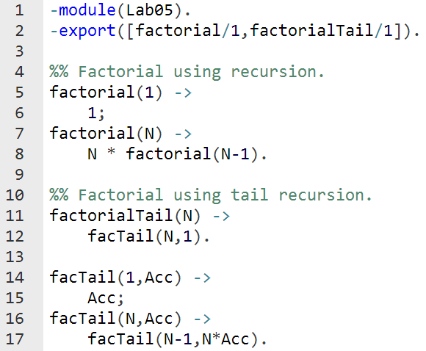
#4 Recursions
It’s important to know the difference between using recursion and tail recursion, in manner of required resources
Think about the factorial of 10⁶
Recursion requires a chain of resources during evaluation
Tail recursion transforms the linear process of recursion into iterative one, by “carrying” the partial answers along the way
https://stackoverflow.com/questions/33923/what-is-tail-recursion

Slide 26
#5 Submission Procedures
Only a single .erl file to be submitted
Filename format: ex3_<ID>.erl
Where <ID> needs to be replaced with your ID number
Your code MUST be well documented
Functions’ names must be identical to the ones defined in exercise
Same as for the arity
Same as for the output format
All names are case sensitive
Only the tested functions needs to be exported
Internal functions MUST NOT be exported
Assignments will be tested automatically in using Erlang shell in Linux
No excuses

Slide 27
5# Submission Procedures
Relevant questions can be asked only in the forum in moodle site or in reception hours.
Uploading code to the forum is forbidden!!!

Slide 28
Exercise 3
sortRes(List, Method)
Sorts List according to the residue of division by 3
Each modulo-grouped list should be sorted by remainder size
Implement three different methods of sorting (export all of them):
List comprehension – sortResLC(List)
Pattern matching – sortResPM(List)
By using lists module – sortResLM(List)
Method is one of atoms: ‘lc’, ‘pm’ , ‘lm’
Example
sortRes([2,3,9,5,6,7,8,1,4,10], Method) → [3,6,9,1,4,7,10,2,5,8]
sortRes([]) → []

Slide 29
Exercise 3
mSort(List)
Returns a sorted List
Implement it to work as merge sort
Example
mSort([1,2,3,1,3,4,7,4]) → [1,1,2,3,3,4,4,7]
qSort(List)
Returns a sorted List
Implement it to work as quick sort
Example
qSort([1,2,3,1,3,4,7,4]) → [1,1,2,3,3,4,4,7]

Slide 30
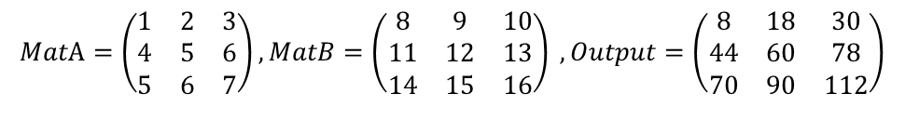
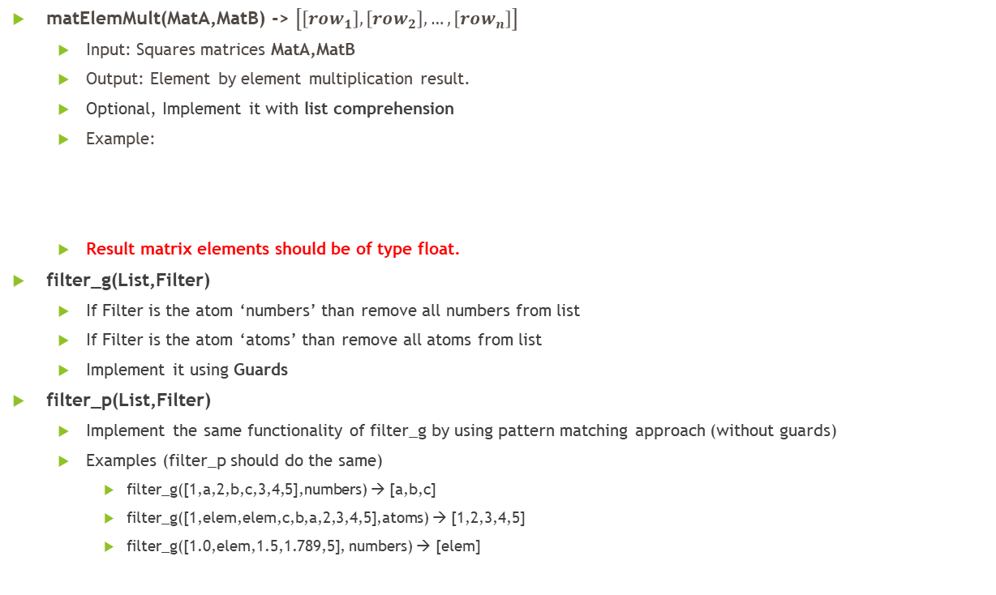
Exercise 3
matElemMult(MatA,MatB) -> $\left[\left[row_{1}\right],\left[row_{2}\right],…,\left[row_{n}\right]\right]$
Input: Squares matrices MatA,MatB
Output: Element by element multiplication result.
Optional, Implement it with list comprehension
Example:
Result matrix elements should be of type float.
filter_g(List,Filter)
If Filter is the atom ‘numbers’ than remove all numbers from list
If Filter is the atom ‘atoms’ than remove all atoms from list
Implement it using Guards
filter_p(List,Filter)
Implement the same functionality of filter_g by using pattern matching approach (without guards)
Examples (filter_p should do the same)
filter_g([1,a,2,b,c,3,4,5],numbers) → [a,b,c]
filter_g([1,elem,elem,c,b,a,2,3,4,5],atoms) → [1,2,3,4,5]
filter_g([1.0,elem,1.5,1.789,5], numbers) → [elem]
$$MatA=\left(\begin{matrix}1 & 2 & 3 \\ 4 & 5 & 6 \\ 5 & 6 & 7\end{matrix}\right),MatB=\left(\begin{matrix}8 & 9 & 10 \\ 11 & 12 & 13 \\ 14 & 15 & 16\end{matrix}\right) , Output=\left(\begin{matrix}8 & 18 & 30 \\ 44 & 60 & 78 \\ 70 & 90 & 112\end{matrix}\right)$$

Slide 31
Exercise 3
even(List)
Returns a list of all even members of List, in the same order as appeared in it
Implement it using a recursion without using reverse()
Hint: use guards
Example
even([1,2,3,4,5,6,7,8,9]) → [2,4,6,8]
even([1,3,4,2,6,5,1]) → [4,2,6]
even([1]) → []

Slide 32
Exercise 3
fiboR(N)
Returns the N’th Fibonacci number (1,1,2,3,5,…)
Implement it using a recursion
Example
fiboR(4) → 3
fiboT(N)
Returns the N’th Fibonacci number (1,1,2,3,5,…)
Implement it using a tail recursion
Example
fiboT(4) → 3
Find which of the last two functions evaluates faster. Write the conclusions as comments inside the .erl file.

Slide 33
Exercise 3
No submission is required for this part.
zeroDiag(N)
Prints a N*N matrix that its diagonals are all ones and the rest are tuples that represent their positions. Returns the matrix represented as a list.
Implement it using list comprehension
Use io module for printing: io:fwrite(“Number: ~p~n”, [N]).
Example
zeroDiag(3) → [[1,{1,2},1],[{2,1},1,{2,3}],[1,{3,2},1]]
1 | {1,2} | 1
{2,1} | 1 | {2,3}
1 | {3,2} | 1

